Slide 1

Future Internet Business Collaboration Networks in Agri-Food, Transport & Logistics
Short introduction
webinar, 24 July 2014
Sjaak Wolfert
Project Coordinator
LEI Wageningen UR

Slide 2


Outline
Future Internet Public Private Partnership (FI-PPP)
FIspace
  B2B platform with App store & B2B collaboration core

Slide 3
FI-WARE serving usage areas

Slide 4
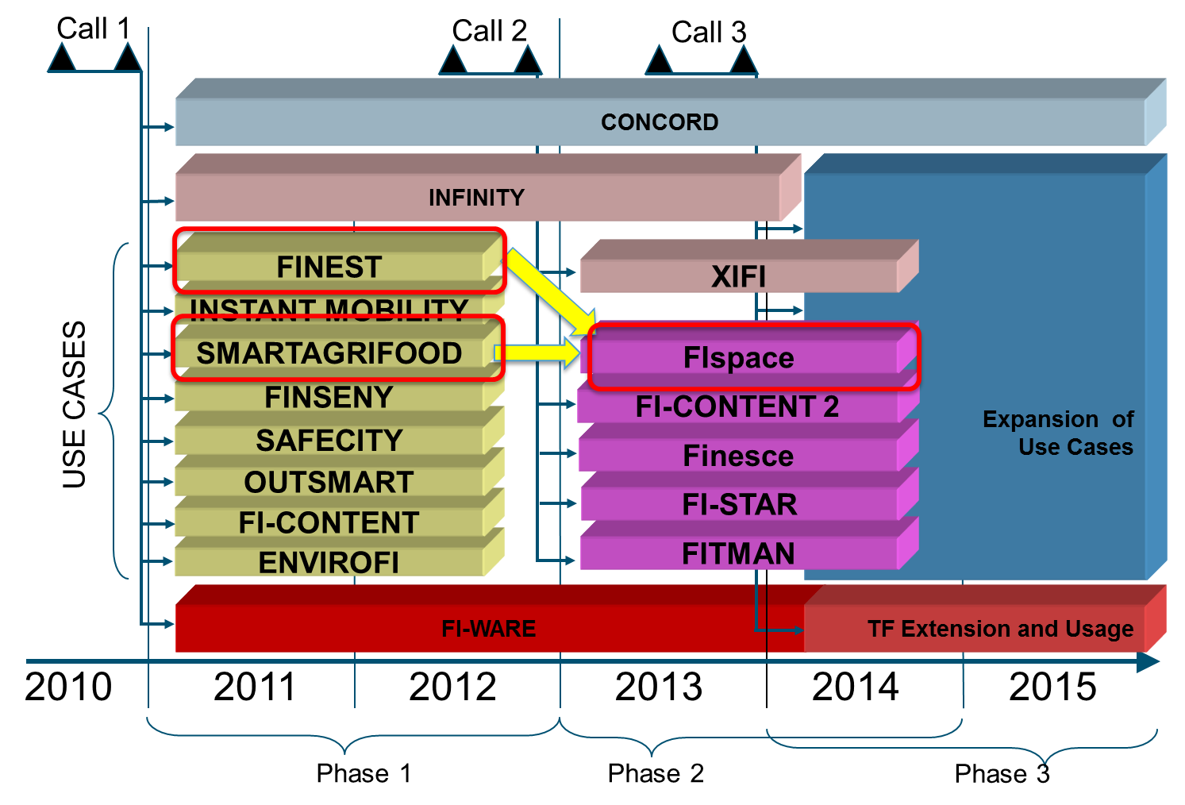
FI-PPP Programme Architecture
90 M€
80 M€
130 M€
Notes:
Platform components:
IoT
Big Data
Cloud hosting
Service management
Service mesh-up
Security

Slide 5
Future Internet Business Collaboration Networks in Agri-Food, Transport & Logistics

Slide 6
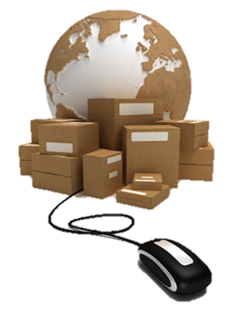

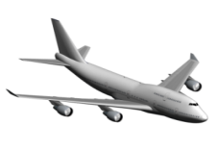
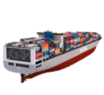





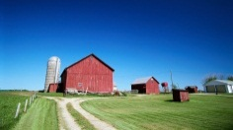
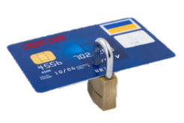
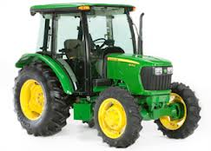
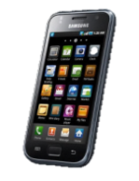







Motivation and Impact
Forwarder
Carriers
FIspace will facilitate:
  … seamless cross-organizational collaboration (information exchange, communication, coordination of activities)
  …unprecedented transparency, visibility and control of processes (using Internet-connected sensors and IoT devices)
  …rapid, easy, low cost development and deployment of customized solutions (apps and services)
  …agile formation of business networks and ecosystems (social networks and app/service markets)
Consultants
Production
Plants
Future Internet Features
Consumers
Internet of Tings
Wireless Sensor Networks
Cloud Computing
Privacy & Security
Location-based
services
Social Media
Internet of Services
Banks
Linked Open Data, Big Data
Insurances
Ports
Customs
Authorities
Agri-Food, Transport and Logistics:
EU turnover: 1,500 billion €
Efficiency: 148-220 billion € savings
Sustainability: 26.5% of CO₂ emissions
Notes:
These sectors together have a huge potential impact on the European economy and society.
EU turnover: 1,500 billion €
Efficiency: 148-220 billion € savings
Sustainability: 26.5% of CO₂ emissions
Here you see a picture of the business network we are dealing with (farmers, carriers, retail, customs, etc.)
They are challenged by all kind of ICT-related developments, such as:
High-quality customer applications, end2end visibility, M2M communication, etc.
But there are currently still quite some bottlenecks to be solved, such as:
Interoperability between current inter-enterprise information systems (still use of paper, fax, phone, etc.)
Tracking and tracing possibilities are still limited (especially e.g. if you want to know what happened to your food between production and consumption)
Especially for SMEs, software is relatively expensive, while the need for flexible, customized solutions has increased
These bottlenecks are the reason for current limited and rather fixed business collaboration networks, hampering innovation in general
Through conceptual prototypes in phase 1 we have made it plausible that FI will significantly contribute to overcoming these bottlenecks by facilitating:
...seamless cross-organizational collaboration
…unprecedented transparency, visibility and control of processes
…rapid, easy, low cost development and deployment of customized solutions
…agile formation of business networks and ecosystems

Slide 7

FIspace platform High Level Architecture
FIspace = the Facebook/LinkedIn for B2B collaboration
T280: Software Development Toolkit:
SDK (ATOS)
Trials:
Crop Protection Information Sharing
Greenhouse Management & Control
Fish Distribution & (Re-)Planning
Fresh Fruit and Vegetables QA
Flowers & Plants SC Chain Monitoring
Meat Information Provenance
Import & Export of Consumer Goods
Tailored Information for Consumers
Base Technologies
T220: User Front-End (ATOS)
T230: App Store (IBM)
GENERIC ENABLERS
T260: Operating Environment
(IBM)
I2ND
T240: B2B Collaboration Core (IBM)
IoT
IoC
IoS
S&T
T250: System & Data Integration (ATOS)
Validation
T270: Security, Privacy, Trust Framework: SPT (KOC)

Slide 8





FIspace approach: Software Mass Customisation
Single App
Configuration
FIspace
App Store
My FIspace (BCM)
Develop
Apps
Pre-configure
User Systems
Customize &
Use Systems
App developer
Business Architect
User (farmer, transporter, ...)
FIspace Platform

Slide 9
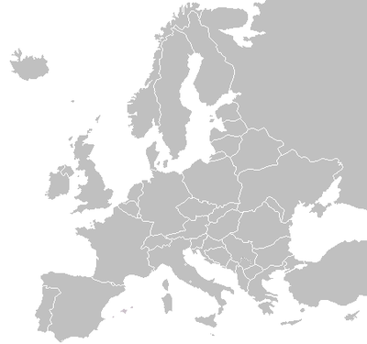
Use Case Trial Experimentation Sites
Farming in the Cloud
  Crop Protection Information Sharing
  Greenhouse Management & Control
  Fish Distribution and (Re-) Planning
  Fresh Fruit and Vegetables Quality Assurance
  Flowers and Plants Supply Chain Monitoring
  Meat Information Provenance
  Import and Export of Consumer Goods
  Tailored Information for Consumers
Intelligent Perishable
Goods Logistics
Smart Distribution
and Consumption
3
1
4
5
6
7
2
8

Slide 10
Project Details
EU Seventh Framework Program (7FP)
  Future Internet Public Private Partnership programme (FI-PPP)
Project type: Collaborative Project - Large-scale Integrated Project (IP)
Total budget: ~ 20 M€
EU funding: 13.5 M€
Duration: April 2013 – April 2015 (Phase II)
Grant Agreement: 604123

Slide 11





























Partners
Partners
Coordinator
Trial
partners
Technical
partners
Knowledge and networking partners
Pert

Slide 12







Open Call partners
BO-MO
Snoop Media
Mobics

Slide 13
FIspace ecosystem development
Farming & Manufacturing
Transport & Logistics
Wholesale & Retail
Health Sector
Industries
(converging)
(Producers, Farmers, Manufacturers, Suppliers, ..)
(Forwarder, Carriers, 3PL / 4PL, Ports, …)
(Warehouses, Supermarkets, Stores, …)
(Banks, Insurances, Authorities, ..´)
T280: Software Development Toolkit:
SDK (ATOS)
Base Technologies
ICT Industry
(going to the Cloud)
T220: User Front-End (ATOS)
Business Configurators
(+ follow up)
GENERIC ENABLERS
T230: App Store (IBM)
I2ND
T260: Operating Environment
(IBM)
App & Service Providers
IoT
T240: B2B Collaboration Core (IBM)
IoC
IoS
S&T
DEVELOPMENT TOOLKIT
T250: System & Data Integration (ATOS)
Cloud Operators & Infrastructure Providers
Validation
T270: Security, Privacy, Trust Framework: SPT (KOC)

Slide 14
Thanks for your attention!
sjaak.wolfert@wur.nl
www.FIspace.eu

