Slide 1
FIspace B2B NetFutures 2015
Moti Nisenson
IBM Research – Haifa

Slide 2
Overview
High level Architecture
Capability Model
Overview of Event Processing Module
Business Collaboration Module
Testing (Experimentation)

Slide 3
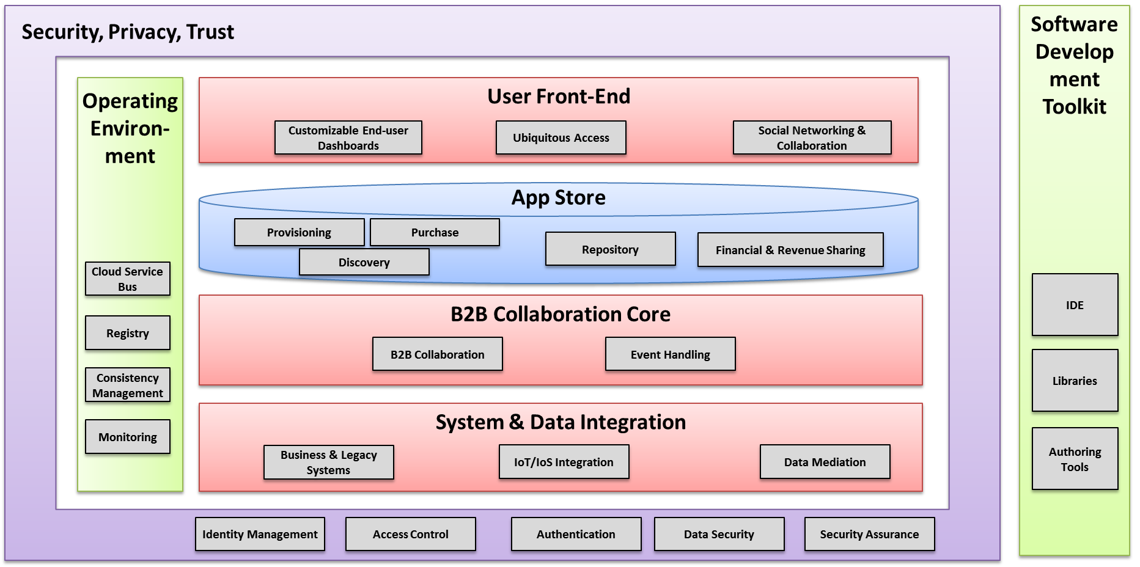
B2B Core Modules – Position in FIspace platform
BCM
EPM
Notes:
B2B Core Modules are an essential part of all FIspace collaborations.
They are composed of two related modules: The BCM accountable for the collaboration process flow, and the EPM which is accountable for the event processing in order to derive situations of interest.
The BCM – based on the artifact-centric paradigm and applies the GSM model
The EPM – based on the CEP GE tool and semantics

Slide 4
High Level Runtime Architecture
FISPACE
B2B
EPM
CSB b2b.in
APP
BACKEND
SDI
CSB
epm.bcm
CSB b2b.out
BCM
APP
BACKEND

Slide 5
Modeling Reusable Services
In order to facilitate reuse, and to enable differentiation between backend/application services, capability types are used
A capability type defines a message interface (request and response message types)
A capability type has an id
A capability is a concrete instance; specifically it defines a URI end-point which implements the message interface
Can have different implementations for the same capability type (e.g., from different companies)

Slide 6
Modeling Reusable Business Processes
A business process template (BPT) is used to describe the collaboration between several capability types
It is implemented in B2B; this is a specification of what to do when receiving different messages (e.g., forward to a capability type)
A business process specifies the actual capabilities participating in a collaboration
Each business process has its own runtime state, but they share the same logic at the BPT level

Slide 7
Capabilities – Business Processes – B2B
APP
BACKEND
Message interface
Implemented at URI
Associated
with
Capability
(URI)
Has Many
Business
Process
B2B State
Instantiates
Instantiates
Accesses
Capability Type
(msg. interface)
Has Many
Business
Process
Template
Implements
B2B Logic

Slide 8
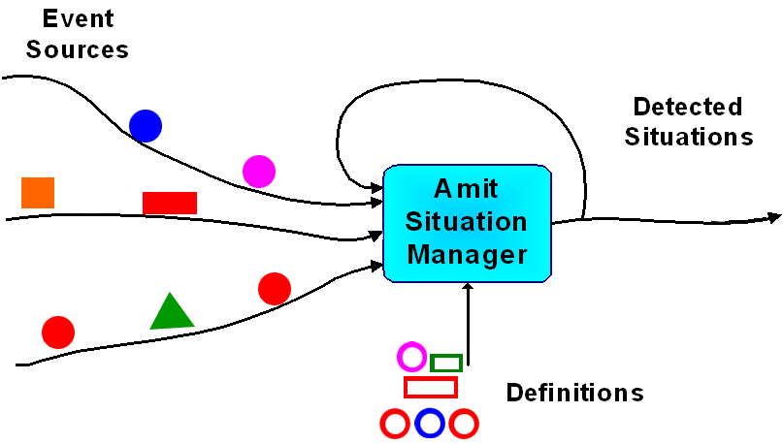
Event Processing Module (EPM) – What is event processing?
Event processing is a form of computing that performs operations on events
Example of a situation: A temperature increase trend in a container is detected whenever the temperature in the permitted range constantly increases within the last 5 minutes
Event patterns

Slide 9
Event Processing Module Quick Overview
EPM is based on Proton, the FIWARE Complex-Event Processing GE
EPM is used for “pattern detection” – examples:
Detect when a sensor value first passes a threshold
Warn if the contents of a truck are getting warmer over time
If a shipment hasn’t arrived within 3 days, then take some action
Often, the action will involve communicating with BCM which handles the collaboration (such as notifying the responsible system)

Slide 10
Business Collaboration Module Architecture
CSB Incoming
CSB Outgoing
BCM
CBBridge
BPT 1 Bridge Configuration
BPT 2 Bridge Configuration
BPT 3 Bridge Configuration
BizArtefact (ACSI)
BPT 1 Logic
BPT 2 Logic
BPT 3 Logic

Slide 11
BCM Concepts
Business Entity
Represents a concept with relevance for the execution of the business process (e.g., Shipment, Order)
This defines state and logic (like a class in OO)
During runtime, instances are created by the bridge
Events
Incoming messages which logic handles
Lifecycle
The implementation of the logic
External Services
What capability types should messages be sent to?

Slide 12
ACSI Configuration
Configuration of BCM Runtime State and Logic for a BPT
Concept
Per instance state
Common Logic
Which incoming messages are handled?
What capability types are messages sent out to?
Templates provide the definitions of
all needed data types for each domain

Slide 13
What is GSM? (I)
GSM is a declarative language for describing data driven workflows
Elements:
Guards
Stages
Milestones
Tasks

Slide 14
What is GSM? (II)
Stage: Cluster of activity intended to achieve milestones. Stages can contain sub-stages.
Substages can only become active if the parent stage is active.
Milestones: Correspond to business relevant objectives and can be achieved from an active stage
Stage Name
Milestone 2
Sub-Stage Name
Milestone 3
Task
Milestone 1
Guards: Define conditions under which the stage can become active
Task: Activity which is executed when a stage becomes active. Can be implemented by a service call to a external system.

Slide 15
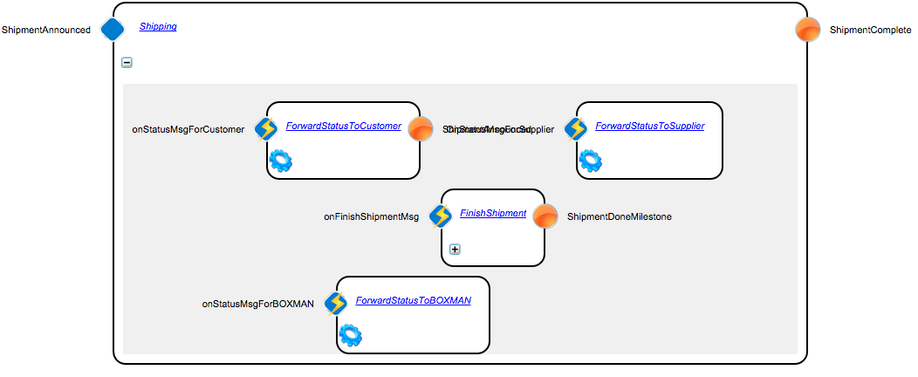
Example Lifecycle
Stage
Guard
Milestone

Slide 16
GSM Model – Common Cases for FIspace
Guards:
When we receive event of type X containing specific data
Require that a milestone has already been achieved
Tasks:
Update state (e.g., save data from a message for later)
Invoke an external service (e.g., send a message to a capability type)
Milestones:
Require that certain sub-stage milestones have already been achieved

Slide 17
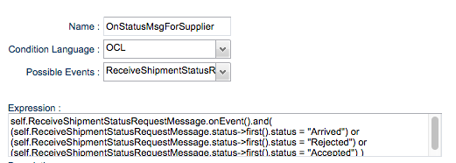
Example: Message Forwarding
Guard: When we receive a ReceiveShipmentStatusRequestMessage whose status is
Arrived, Rejected or Accepted

Slide 18
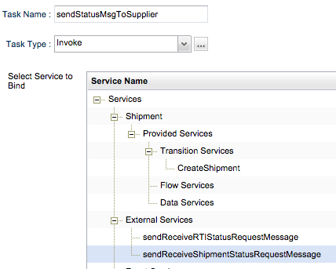
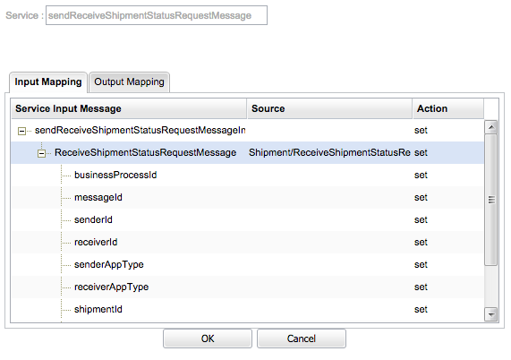
Example: Message Forwarding
Task: Forward the received message
The definition of the external service includes the destination capability type id

Slide 19
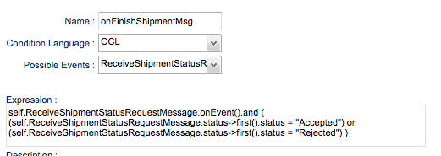
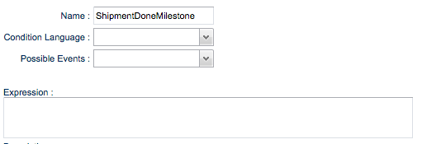
Example: Completing Stages
Guard: When we receive a ReceiveShipmentStatusRequestMessage whose status is
Accepted or Rejected
Milestone:
Always set the
ShipmentDoneMilestone
to true

Slide 20
Correlation Keys
A correlation key is how B2B knows which state to access
The correlation key is built from fields in the messages and should always include the business process id
It can also include further information; in our shipment example, it is <business process id, shipment id> - this allows to have separate state for each shipment

Slide 21
BCM Basic Testing
Within the authoring tool can create Business Entity instances and can simulate sending messages
This allows testing by checking what stages are active, what tasks get run, and how the state is updated
When done authoring, can download as a zip and then deploy to a runtime environment

Slide 22
Advanced Testing – Experiments (Quick Overview)
FIspace includes Experimentation tooling
This allows to define Experiments, which include specific steps to be taken (in actual applications), and executes with the actual platform
The tooling support simulating different apps and systems so tests can be performed in isolation
KPIs are also gathered during execution

Slide 23
Questions….

Slide 24
Backup Slides

Slide 25
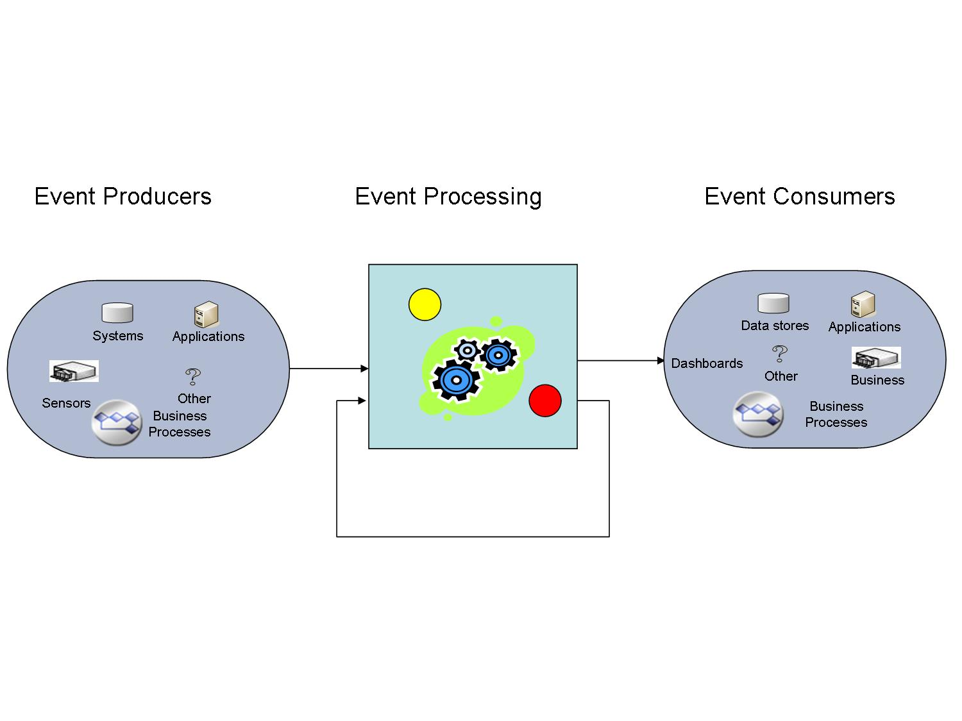
Event Processing Module (EPM)
Based on the notion of an Event Processing Network (EPN)
Collection of Event Processing Agents (EPAs)
Collection of Producers
Collection of Consumers
Notes:
The EPM is based on the notion of an Event Processing Network (EPN), i.e. a collection of Event Processing Agents (EPAs), producers, and consumers. An EPA is a software module that processes events. An event producer is an entity at the edge of an event processing system that introduces events into the system. An event consumer is an entity at the edge of an event processing system that receives events from the system.
Diagram of Event Driven Architecture. Inside the EP we have different EPA s, each performing a different function on a set of events.

Slide 26
Example: Greenhouse scenario
Sensor events are received in the EPM that checks whether all the sensor values are in the permitted range. It emits a notification alert whenever
At least one of the sensor values is not in the permitted range and there is no pending Advice for the specific (farmID and cropID)
Allowed sensor values:
10 ≤ temperature ≤ 33
5 ≤ luminosity ≤ 40
50 ≤ airHumidity ≤ 80
5 ≤ PH ≤ 7
1.5 ≤ EC ≤ 3.5
60 ≤ soilMoisture 90
200 ≤ CO2 ≤ 1000
Notes:
In order to minimize the number of alerts it only emits one notification/alert per specific (farmerID+cropID), until an Advice is received for the same (farmerID+cropID). Otherwise, for each exception it emits an alert and ask for advice for the same farmID and cropID.

